Slide 1
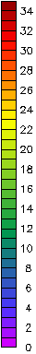
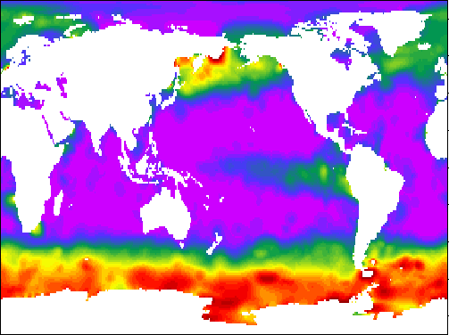
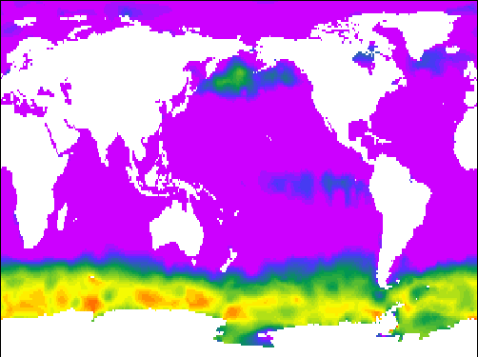
NO₃⁻ (annual maximum)
High nutrient-low chlorophyll regions
[NO₃⁻] (μM)
NO₃⁻ (annual minimum)

Slide 2
NO₃⁻ (annual maximum)
High nutrient-low chlorophyll regions
[NO₃⁻] (μM)
“Give me half a tanker of iron and I’ll give you an ice age”
John Martin, 1990
NO₃⁻ (annual minimum)

Slide 3
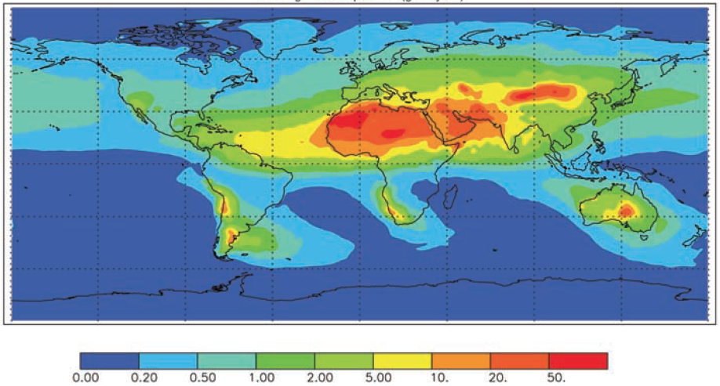
Sources of iron: dust
15%
43%
25%
6%
4%
6%
Average dust deposition (g/m²/year)
Jickells et al. 2005

Slide 4
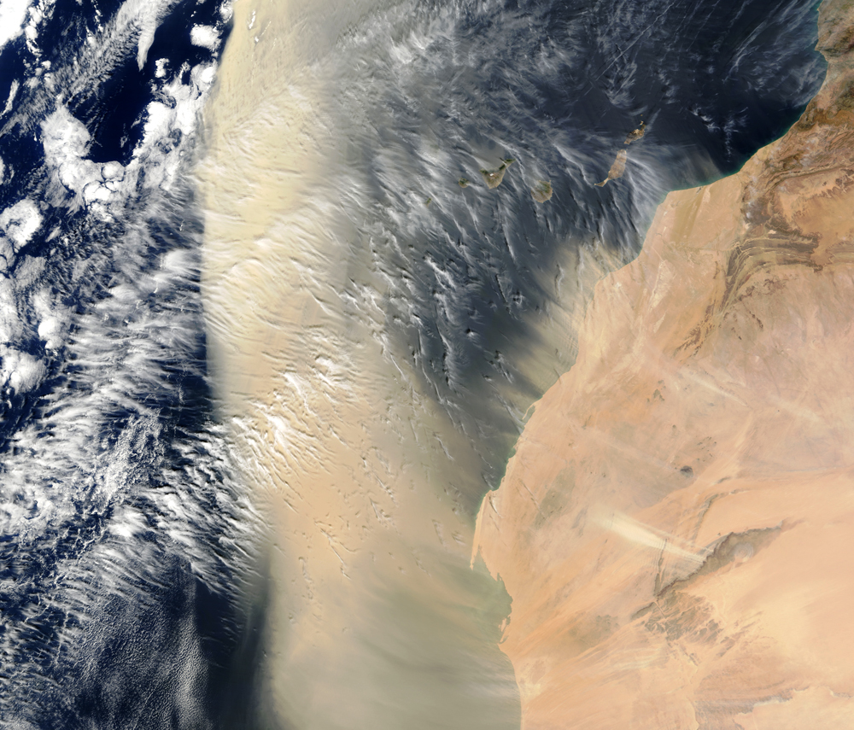
Dust “fertilizes” the ocean with iron

Slide 5
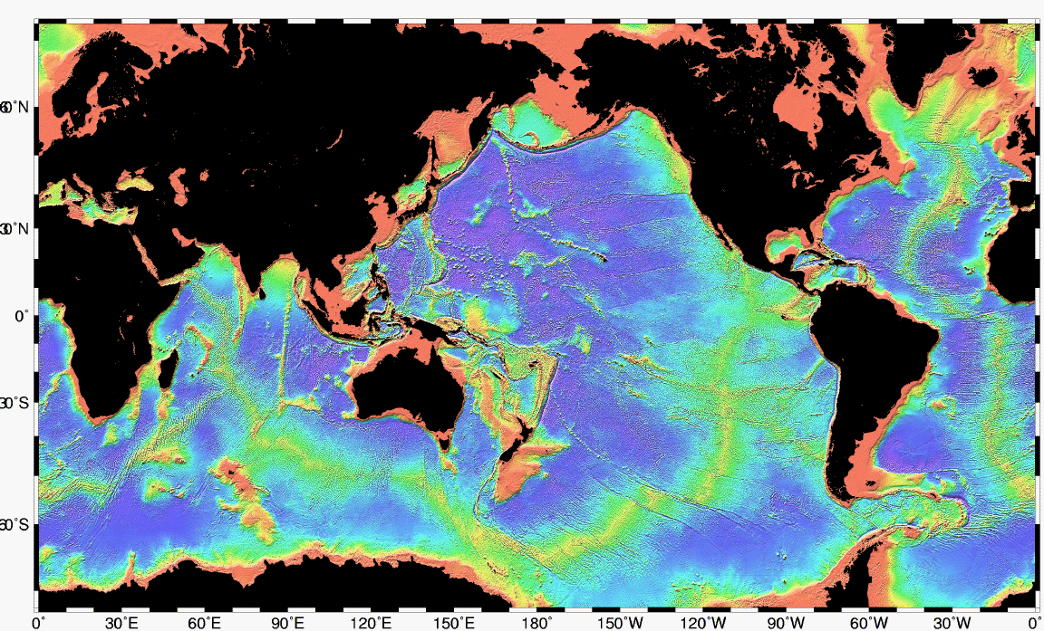
Sources of iron: sediment resuspension
Iron supply highest near the continents
Bathymetry

Slide 6
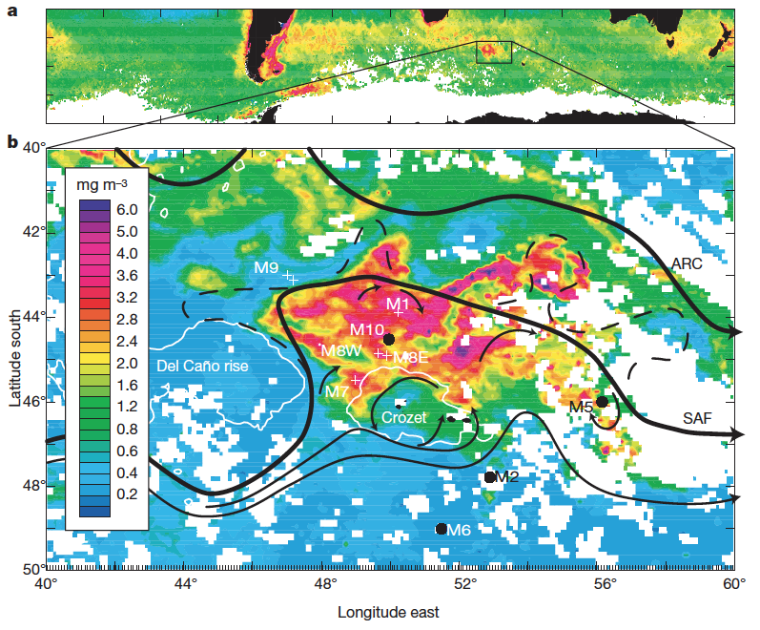
Natural iron fertilization experiment
Crozet plateau
Pollard et al. 2009

Slide 7
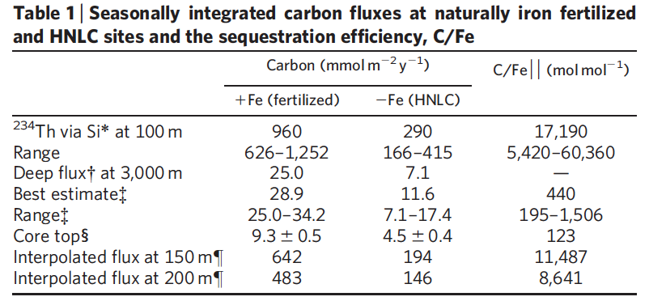
Natural iron fertilization experiment
Addition of iron strengthens the SO biological pump
Pollard et al. 2009

Slide 8
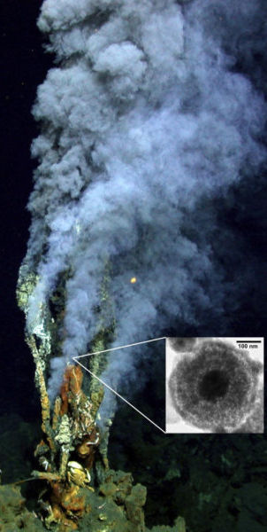
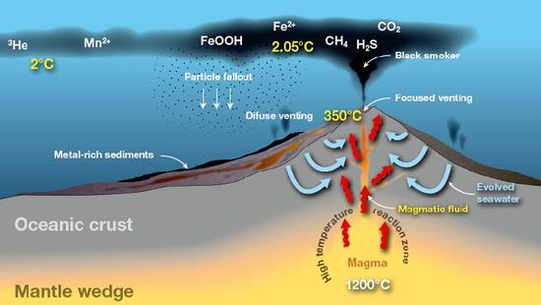
Sources of iron: hydrothermal

Slide 9
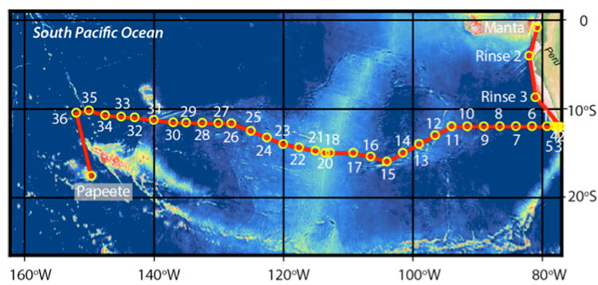
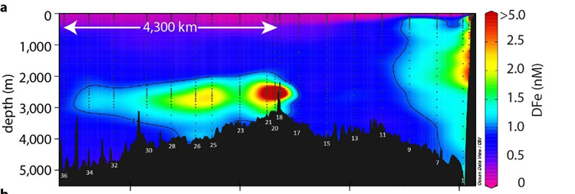
Sources of iron: hydrothermal
Resing et al. 2015

Slide 10
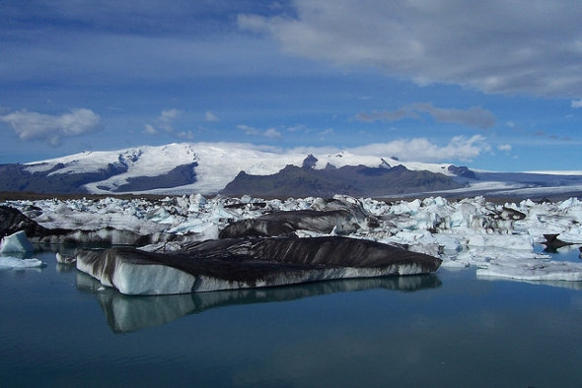
Sources of iron: ice
Atmospheric iron trapped in ice
Iron particles scraped from bedrock by moving ice

Slide 11
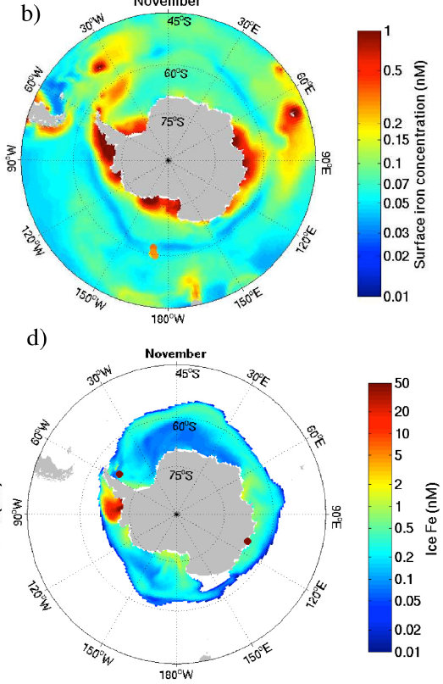
Sources of iron: ice
Seawater iron concentrations (spring)
Iron concentrations in ice (spring)
Wang et al. 2014

Slide 12
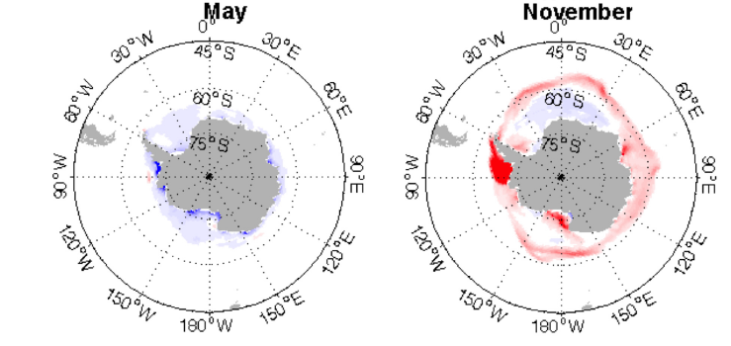
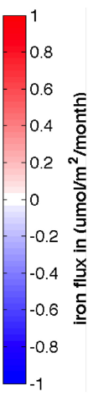
Sources of iron: ice
Iron fluxes: blue – from seawater to ice; red – from ice to seawater
Autumn: iron is removed from seawater by ice formation
Spring: Iron is released to seawater during ice melt
Wang et al. 2014

Slide 13
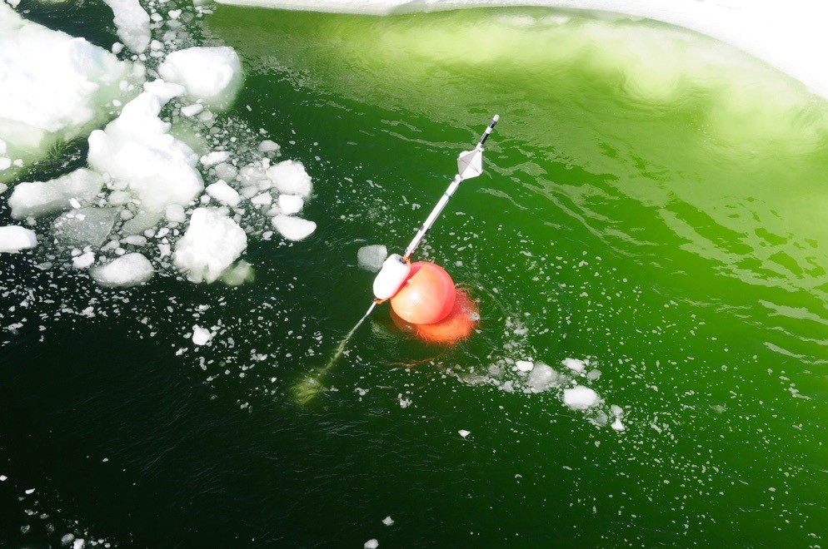
Sources of iron: ice
Ice-edge phytoplankton bloom

Slide 14
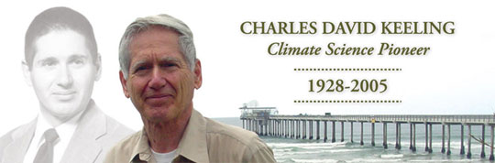
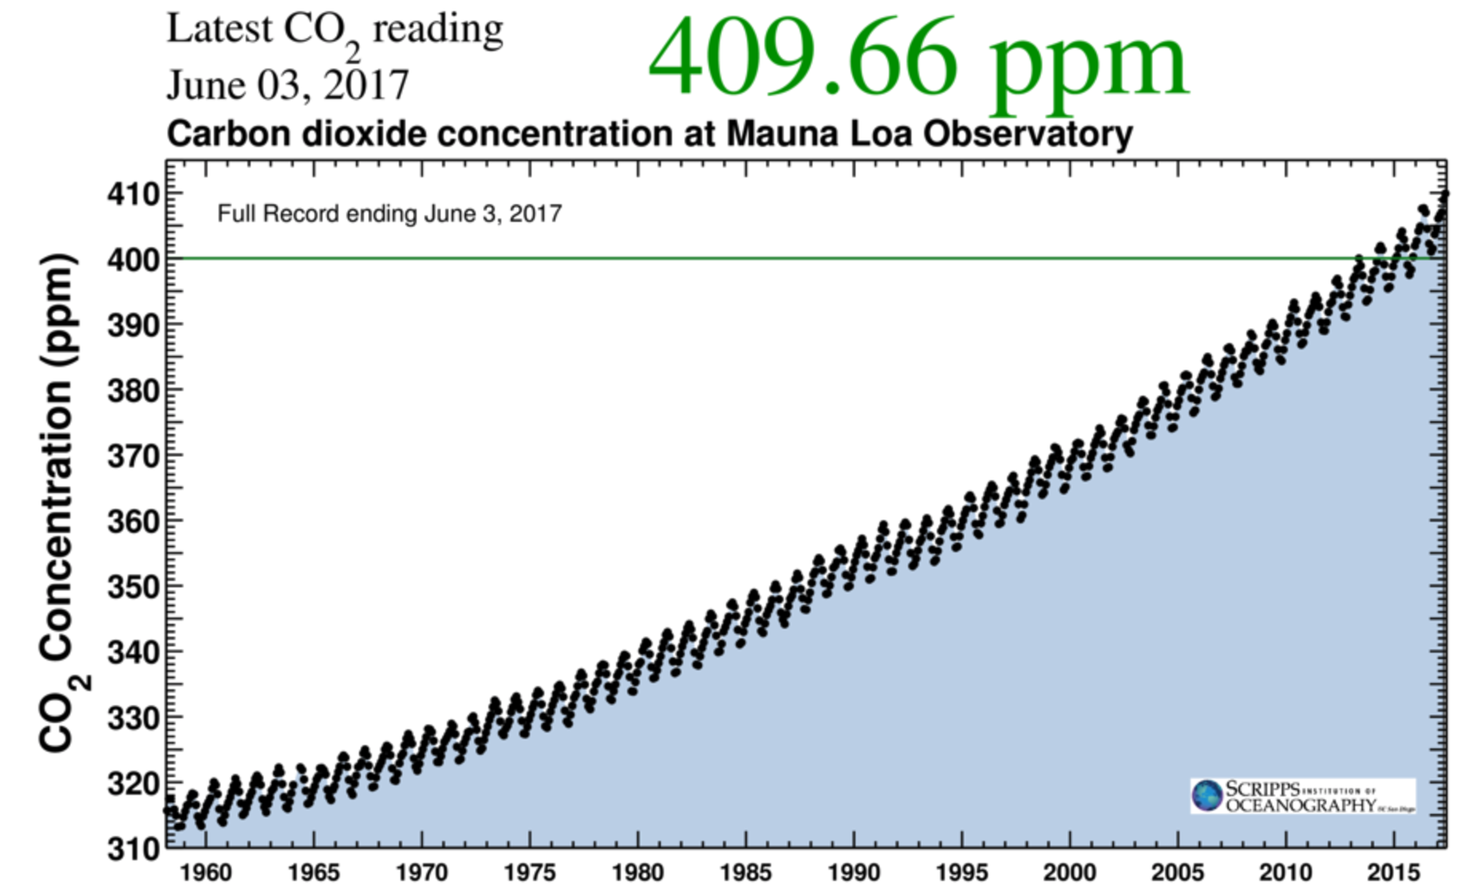
Atmospheric CO₂:
the Keeling curve

Slide 15
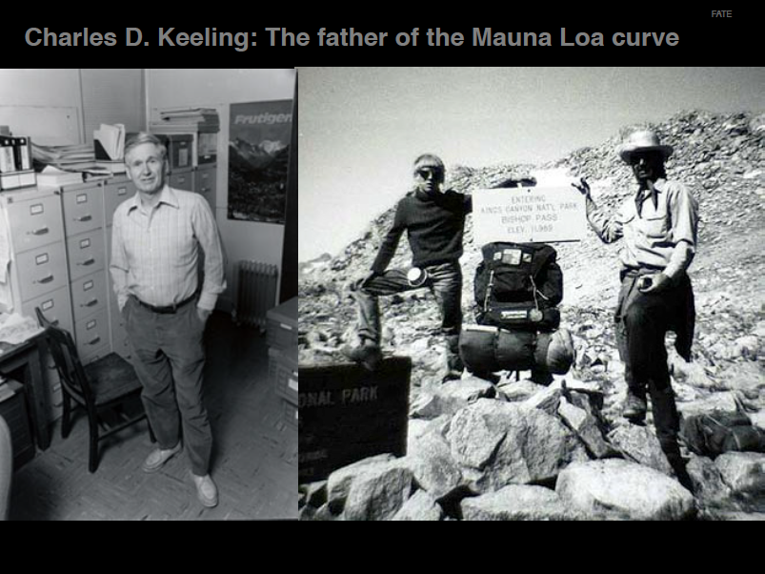

Slide 16
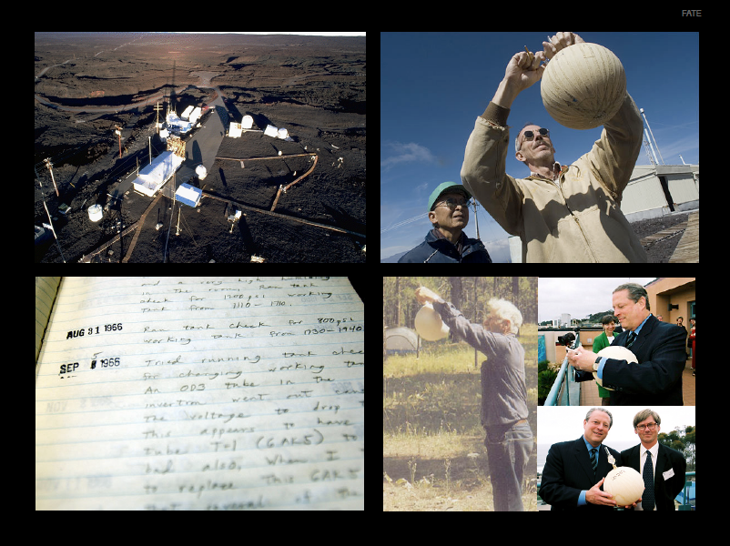

Slide 17
Anthropogenic CO₂ in the atm
www.esrl.noaa.gov

Slide 18
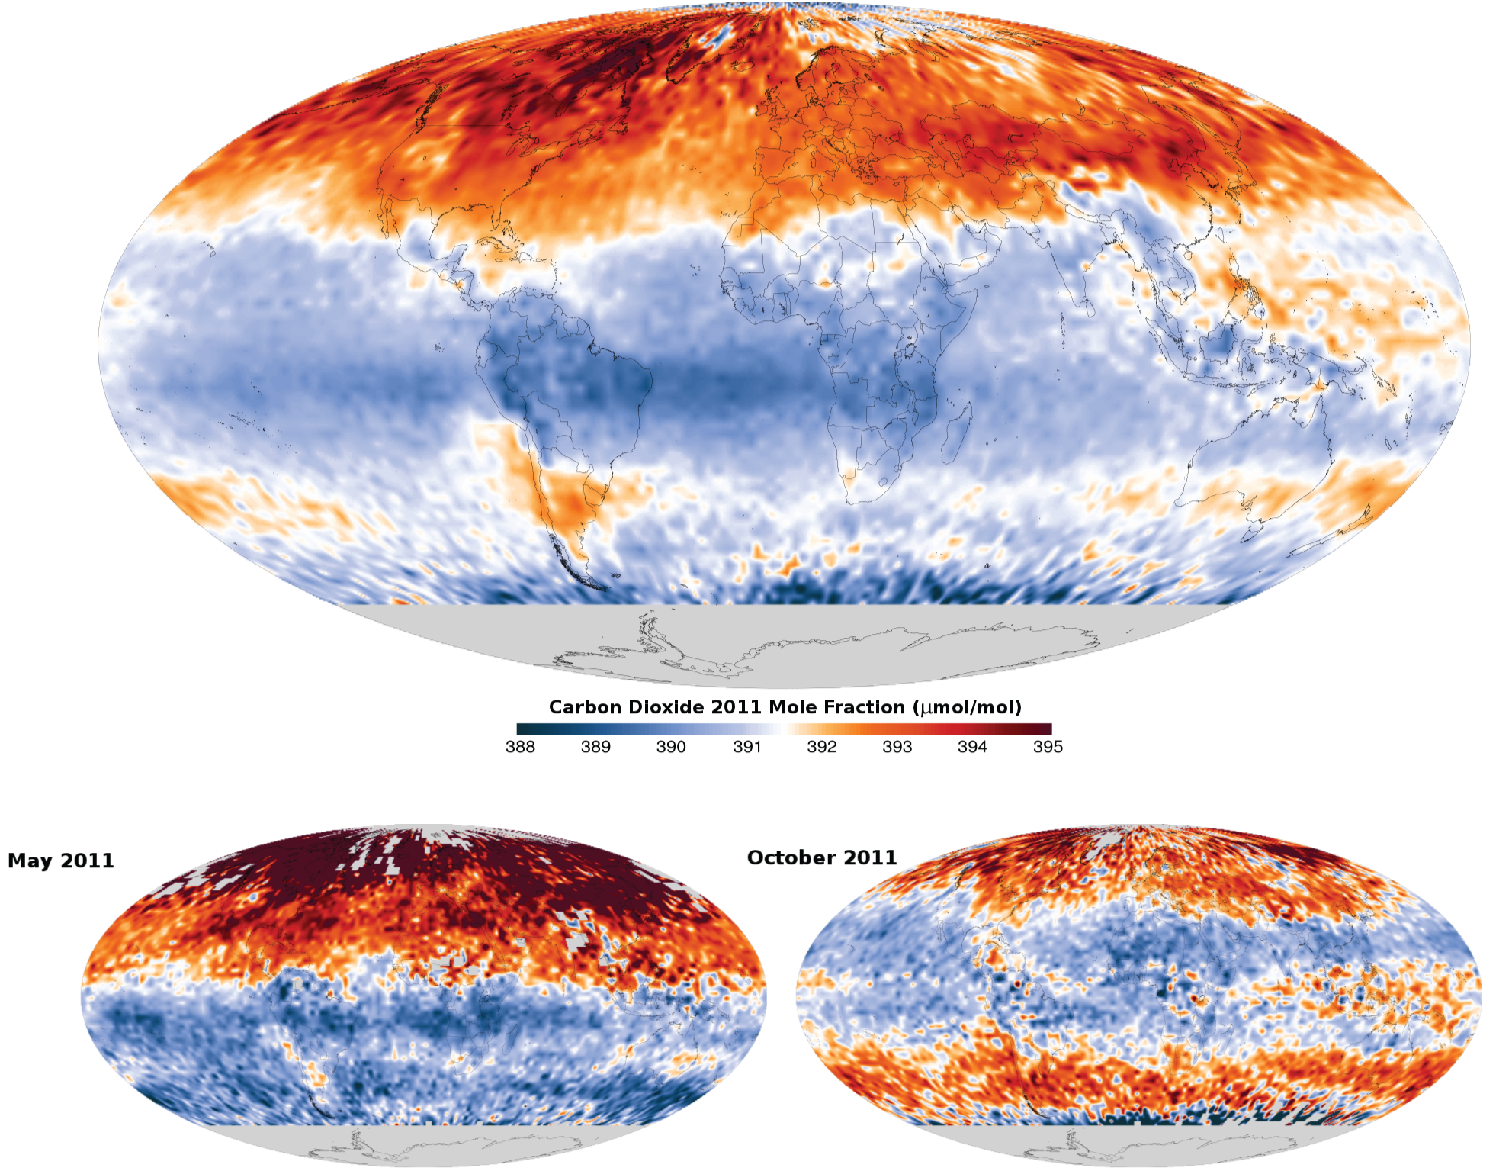
CO₂ in the atmosphere
annual
average
May
October
http://mirador.gsfc.nasa.gov

Slide 19
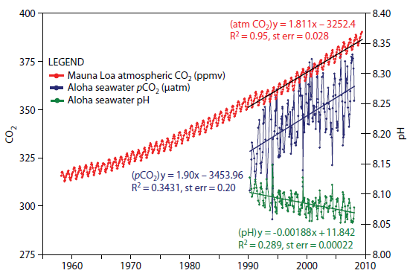
CO₂ in the ocean
atmospheric CO₂
oceanic
CO₂
pH

Slide 20
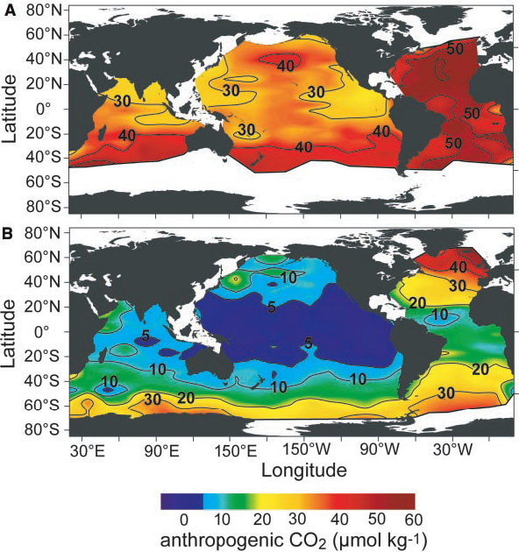
surface
subsurface
Anthropogenic CO₂
Sabine et al. 2004

Slide 21
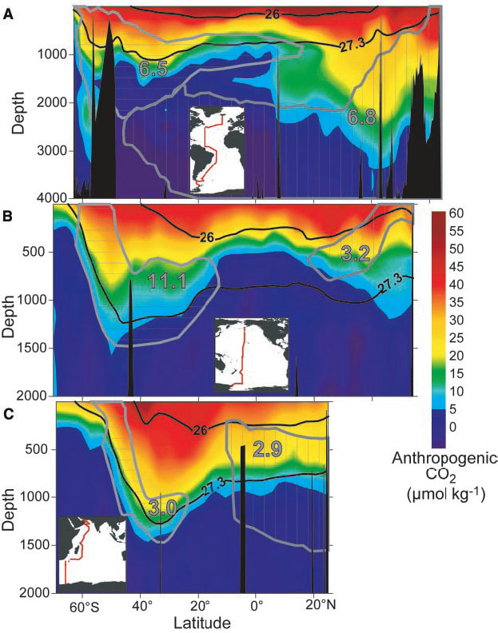
Atlantic*
south
north
Pacific
Indian
Anthropogenic CO₂
Sabine et al. 2004

Slide 22
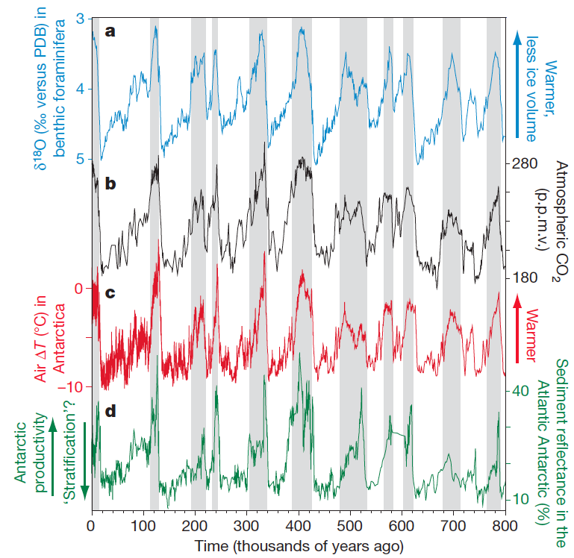
Sigman et al. 2010
Notes:
Grey bars = interglacial

Slide 23
How do we explain the 80-100 ppm CO₂ decrease during the glacials?
Sigman et al. 2010
Notes:
Grey bars = interglacial

Slide 24
You tell me….

Slide 25
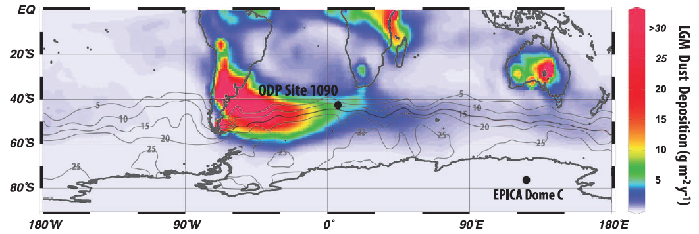
Glacial dust deposition (LGM)
Martínez-García et al. 2014

Slide 26
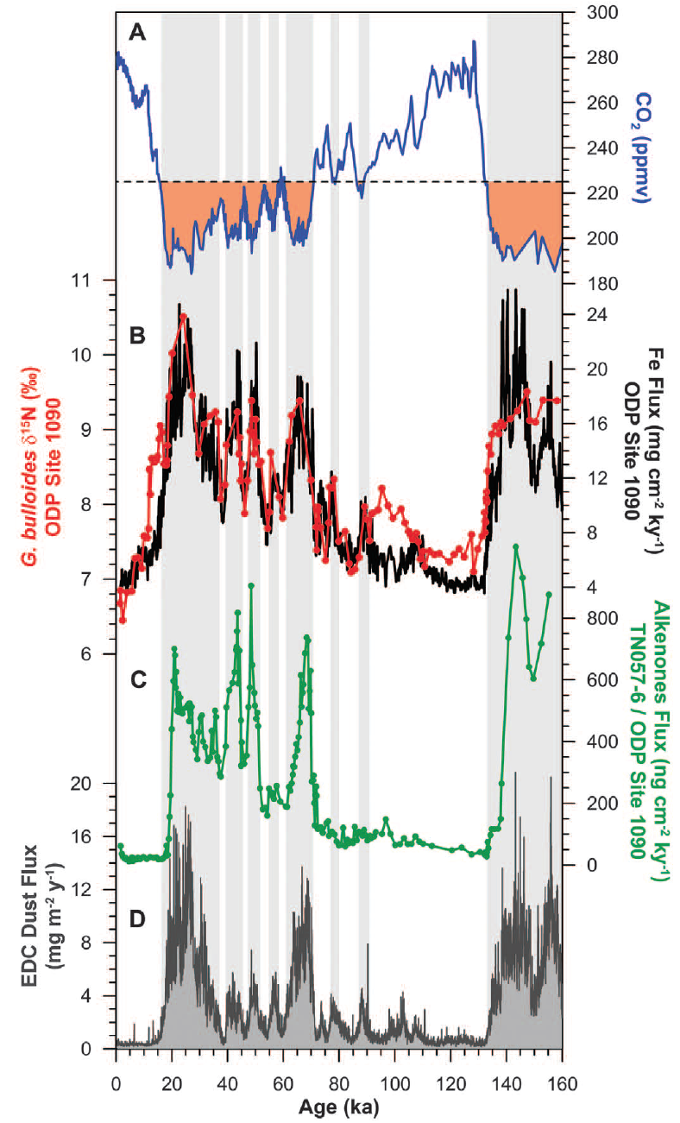
atmospheric CO₂
aeolian iron flux
degree of nitrate consumption
export production
Antarctic dust flux
Martínez-García et al. 2014

